Slide 1
INTRODUCTION TO COMPUTER GRAPHICS & OPENGL

Slide 2
Administration
Total number of lectures: 36 (3 credit course)
Mid Sem- 20%
End Sem- 50%
IA- 30%
2 Class tests - 50%
2 quiz – 40%
Attendance- 10%

Slide 3
Books/ Material
Computer Graphics-C version by Donald Hearn & M. Pauline Baker
Computer Graphics with OpenGL by Donald Hearn & M. Pauline Baker
Mathematical elements for Computer Graphics; by D. F. Rogers and J. A. Adams
Procedural elements for Computer Graphics; by D. F. Rogers and J. A. Adams

Slide 4
Contents
Overview of computer graphics
Computer graphics application and software
Description of graphics devices
Introduction to pixel

Slide 5
Introduction
Computer Graphics is the use of computer to define, store, manipulate and present pictorial output.
A picture is worth a thousand words!
Typically, the term computer graphics refers to several different things:
The representation and manipulation of image data by a computer
The various technologies used to create and manipulate images
The sub-field of computer science which studies methods for digitally synthesizing and manipulating visual content

Slide 6
What is Computer Graphics?
Creation, Manipulation, and Storage of geometric objects (modeling) and their images (rendering)
Display those images on screens or hardcopy devices
Image processing
Others: GUI, Haptics, Displays (VR)...

Slide 7


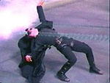
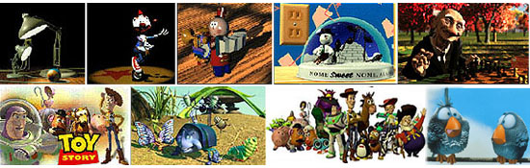
What drives computer graphics?
Movie Industry
Leaders in quality and artistry
Not slaves to conceptual purity
Big budgets and tight schedules
Reminder that there is more to
CG than technology
Hey, How'd they do that?
Defines our expectations
Slide information from Leonard McMillian's slides
http://www.cs.unc.edu/~mcmillan/comp136/Lecture1/compgraf.html

Slide 8

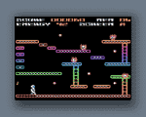
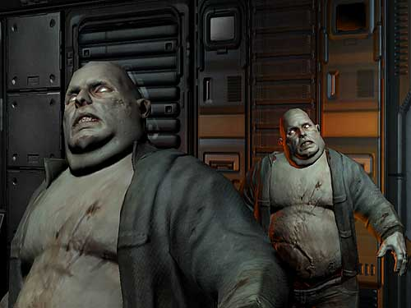
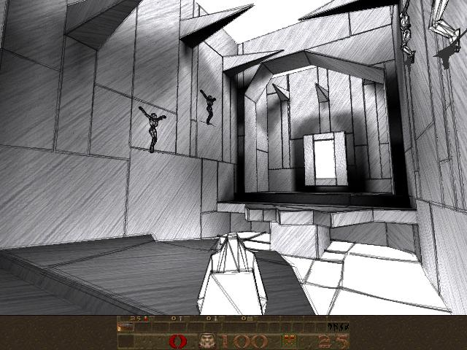
What drives computer graphics?
Game Industry
The newest driving force in CG
Why? Volume and Profit
This is why we have commodity GPUs
Focus on interactivity
Cost effective solutions
Avoiding computating and other tricks
Games drive the baseline
Slide information from Leonard McMillian's slides
http://www.cs.unc.edu/~mcmillan/comp136/Lecture1/compgraf.html

Slide 9
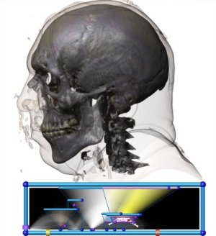
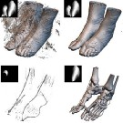
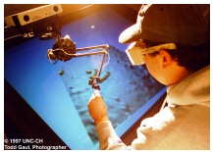
What drives computer graphics?
Medical Imaging and Scientific Visualization
Tools for teaching and diagnosis
No cheating or tricks allowed
New data representations and modalities
Drive issues of precision and correctness
Focus on presentation and interpretation of data
Construction of models from acquired data
Nanomanipulator, UNC
Joe Kniss, Utah
Gordon Kindelman, Utah

Slide 10
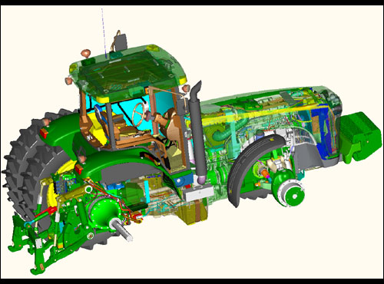
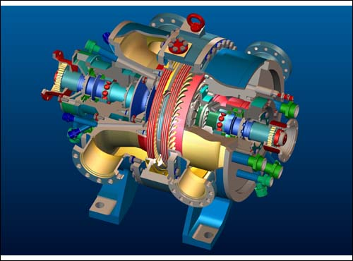
What drives computer graphics?
Computer Aided Design
Mechanical, Electronic, Architecture,...
Drives the high end of the hardware market
Integration of computing and display resources
Reduced design cyles == faster systems, sooner
ProEngineer, www.ptc.com

Slide 11
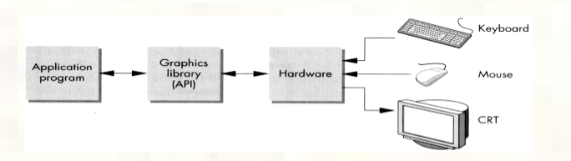
Framework of Graphics System

Slide 12
Computer Graphics System could be:
Active : User controls the display with the help of a GUI, using an input device (ex. Videogame)
Passive: User cannot control the display (ex. Television)

Slide 13
Computer Graphics Vs Image Processing Vs Computer Vision
Computer graphics referred to the process of creating images from abstract models.
A computer game, for example, might internally keep track of Mario as a large list of points, where each point has three numbers representing its (x, y, z) coordinates. Then, given the coordinates of the camera, and the direction its facing, the computer will calculate the color at each row and column in the final image of Mario that you see on your screen.

Slide 14
Computer Graphics Vs Image Processing Vs Computer Vision
Image processing refers to the process of starting with an existing image and refining it in some way to obtain another image.
For example, if you take a picture with your camera, you would use an image processing algorithm to try and make the colors more vibrant, or remove the blur, or increase the resolution. The output of an image processing algorithm is another image.

Slide 15
Computer Graphics Vs Image Processing Vs Computer Vision
Computer vision, that refers to the process of computing an abstract model given an input image. For example, if you take a picture of a statue of Mario, a vision algorithm would infer the list of (x, y, z) coordinates of the points that make up Mario from the colors at each row and column in the input image.

Slide 16
Fundamental Concepts and Principles in Computer Graphics
Display Systems: Random scan, Raster refresh displays, CRT basics, video basics, Flat panel displays.
Transformations
Affine ( 2-D and 3-D ): Rotation, Translation, Scale, Reflection and Shear.
Viewing: The Camera Transformations perspective, isometric views.
Scan Conversion and Clipping: Drawing of Points, Lines, Markers, Curves, Circles, Ellipse, Polyline, Polygon. Area filling, fillstyle, fill pattern, clipping algorithms, anti-aliasing etc.

Slide 17
Hidden Surface Removal: Back face culling, Painter's algorithm, scanline algorithm, BSP-trees, Z-buffer/sorting, Ray tracing etc.
Shading & Illumination: Phong's shading model, texture mapping, bump mapping, Gouraud shading, Shadows and background, Color models etc.
Solid Modeling: Wire-frame, Octrees, Sweep, Boundary representations, Constructive Solid Geometry.

Slide 18
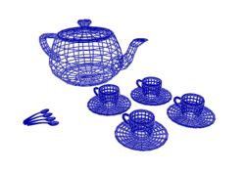
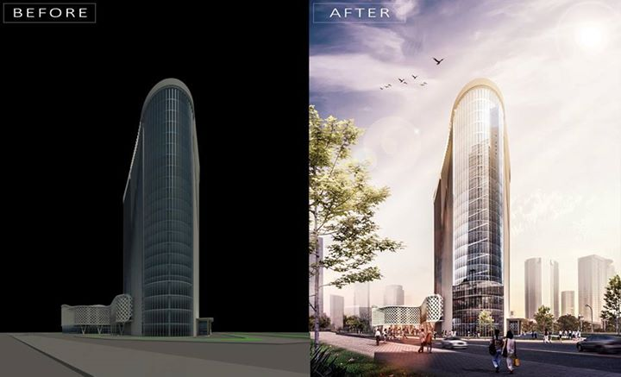
Basic elements of computer graphics
Modeling: the process of developing a mathematical representation of any surface of an object.
Rendering: In 3-D graphic design, rendering is the process of add shading, color and illumination to a 2-D or 3-D wireframe in order to create life-like images on a screen.

Slide 19

Animation: refers to the moving images.

Slide 20
Various APIs used for Computer Graphics
GKS (Graphics Kernel System)
SRGP (Simple Raster Graphics Package)
PHIGS (Programmers Hierarchical Interactive Graphics System)
OpenGL
X-11 based systems
Direct3D (a subset of DirectX)
Glide API
Mantle developed by AMD.
Metal developed by Apple.
QuickDraw 3D developed by Apple Computer starting in 1995, abandoned in 1998

Slide 21
Computer Graphics Software
Photoshop
Illustrator
Paint Shop Pro
CorelDRAW
Adobe Lightroom
Realsoft
Digital Image Suite
Canva
Picasa and many more

Slide 22
Computer Graphics Devices
CRT
EGA/CGA/VGA/SVGA monitors
Plotters
Data matrix
Laser printers
Flat panel devices
Video digitizers
Scanners
LCD panels
Keyboard, joystick, mouse
Touch screen, track ball, etc.

Slide 23
Pixel
A pixel is the smallest unit of a digital image or graphic that can be displayed and represented on a digital display device.
A pixel is the basic logical unit in digital graphics. Pixels are combined to form a complete image, video, text or any visible thing on a computer display.
A pixel is also known as a picture element.

Slide 24
Basic Relationships Between Pixels
Neighborhood
Adjacency
Connectivity
Paths

Slide 25
Types of CRT Display Devices
The most commonly used display device is the
CRT monitor.
Types of CRT display devices:
DVST (Direct View Storage Tube)
Calligraphic or Random Scan display system
Refresh and raster scan display system

Slide 26
Graphics Display Devices (CRT)
The primary output device in a graphical system is the video monitor.
The main element of a video monitor is the Cathode Ray Tube (CRT)
CRT : still the most common video display device presently
Consists of:
Electron gun
Electron focusing lens
Deflection plates/ coils
Electron beam
Phosphorous coated screen

Slide 27
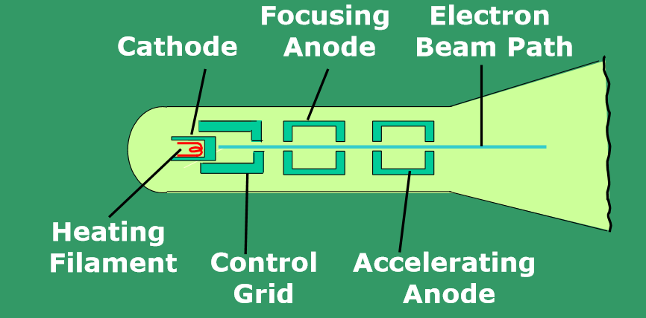
Operation of an Electron Gun

Slide 28
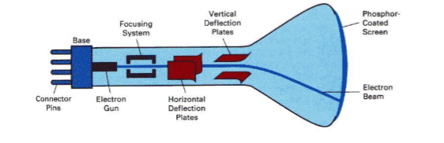
Electrostatic Deflection of the Electron Beam in a CRT

Slide 29
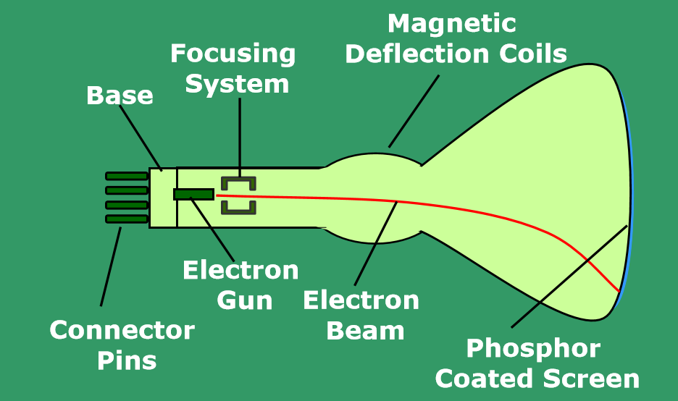
Basic design of a Magnetic Deflection CRT

Slide 30
DVST (Direct View Storage Tube)
Storage Tube- It is a CRT with a long persistence phosphor.
Pictures drawn on there will be seen for several minutes before fading.
Provides flicker-free display.
Instead of the electron beam directly writing the pictures on the phosphor coated CRT screen, the writing is done with the help of a fine-mesh wire grid.
A pattern of positive charges is deposited on the grid and this pattern is transferred to the phosphor coated CRT by a continuous flood of electrons.
This flood of electrons is produced by a "flood gun"

Slide 31
Just behind the storage mesh is a second grid called the collector.
The function of the collector is to smooth out the flow of flood electrons.
Since a large number of electrons are produced at high velocity by the flood gun, the collector grid, which is also negatively charged reduces the acceleration on these electrons and the resulting low velocity flood pass through the collector and get attracted by the positively charged portions of the storage mesh (Since the electrons are negatively charged), but are repelled by the other portions of the mesh which are negatively charged (Note that the pattern of positive charges residing on the storage mesh actually defines the picture to be displayed).

Slide 32
Thus, the electrons attracted by the positive charges pass through the mesh, travel on to the phosphor coated screen and display the picture.
Since the collector has slowed the electrons down, they may not be able to produce sharp and bright images

Slide 33
Drawbacks of DVST
Selected part of picture cannot be erased.
To modify a picture the whole picture has to be redrawn which takes lot of time in case of complex pictures.
Not able to produce sharp and bright images.
No animation possible with DVST.

Slide 34
Random Scan Display
Also known as Calligraphic displays, vector displays or stroke displays.
The CRT's electron beam is directed only to the parts of the screen where a picture is to be drawn.
Characters are also made of sequences of strokes (or short lines)
Vectored – electron beam is deflected from end-point to end-point
Random scan -Order of deflection is dictated by the arbitrary order of the display commands
Phosphor has short persistence –decays in 10-100 micro seconds.

Slide 35
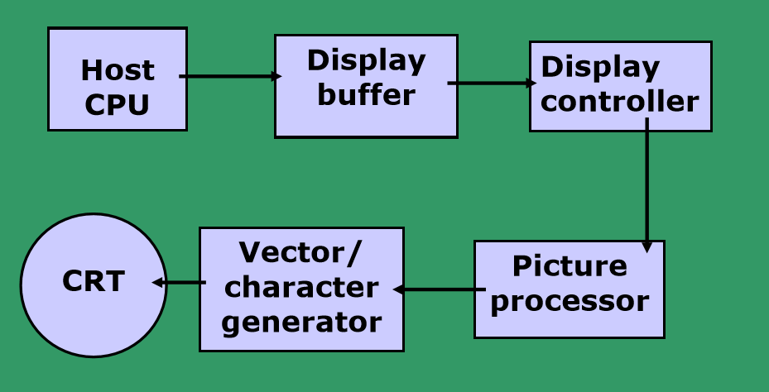
Architecture of Calligraphic Display

Slide 36
The display must be refreshed at regular intervals –minimum of 30 Hz (fps) for flicker-free display
Refresh Buffer/ Display buffer–memory space allocated to store the display list or display program for the display processor to draw the picture
The display processor interprets the commands in the refresh buffer for plotting
To display a picture, the system cycle through the set of commands in the display file, drawing each component line in turn
The display program has commands for point, line, and character plotting
The display processor sends digital and point coordinate values to a vector generator

Slide 37
The vector generator converts the digital coordinate values to analog voltages for the beam-deflection circuits
The beam-deflection circuits displace the electron beam for writing on the CRT’s phosphor coating
Recommended refresh rate is 40 –50 Hz.
Scope of animation– mixture of static and dynamic parts of a picture

Slide 38
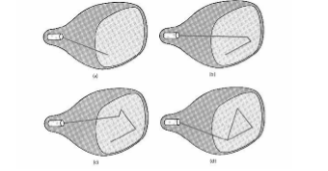
Random Scan Display

Slide 39
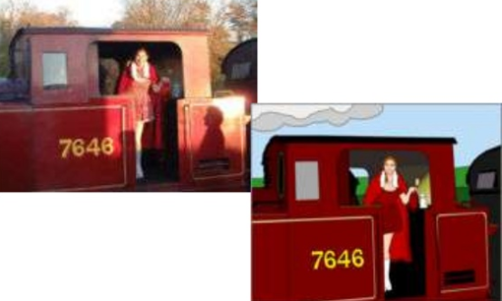
Drawback
Random scan displays are designed for line drawing applications and cannot display realistic shaded scenes
Since picture definition is stored as a Set of line-drawing instructions and not as a set of intensity values for all screen points

Slide 40
Some Terms
Phosphor’s Fluorescence is the light emitted as electrons (unstable) lose their excess energy while the phosphor is being struck by electrons
Phosphorescence is the light given off by the return of the relatively more stable excited electrons to their unexcited state once the electron beam excitation is removed
Phosphor’s persistence is defined as the time from the removal of excitation to the moment when phosphorescence has decayed
long persistence : several seconds or minutes
short persistence :10-60 µs (common in modern displays)

Slide 41
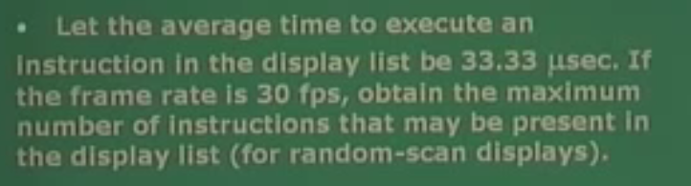
Question

Slide 42
The problem says that we have a frame rate of about 30 hertz that is the frame rate and from that we can easily obtain time to scan one frame. The time to scan one frame multiplied by the frame rate is the number of frames per second fps or hertz gives one second. So time to scan is 1 by that value which is 1/30 seconds or 33.3 milliseconds, 33/3 into 10 to the power minus 3 that is the engineering unit, milliseconds and hence since the problem states that the time to execute anything instruction is only 33.33 microseconds that is 10 to the power minus 6 unit here and time you have actually is 10 to the power minus 3 the unit here for one frame. So, total number of instructions should be this divided by this 33.3 and the answer is very easy that you can actually put 1000 frames per second. That is very easy to compute, the answer t is 1000 microsecond.

Slide 43
Raster Scan Display
Used in television screens, display monitors etc.
Unlike DVST and random-scan which were line-drawing devices, refresh CRT is a point-plotting device
Refresh buffer (also called frame buffer) stores the drawing primitives in terms of points and pixels components
The electron beam is swept across the screen one row at a time from top to bottom. As it moves across each row, the beam intensity is turned on and off to create a pattern of illuminated spots. This scanning process is called refreshing.
Each complete scanning of a screen is normally called a frame.

Slide 44
The refreshing rate, called the frame rate, is normally 60 to 80 frames per second, or described as 60 Hz to 80 Hz.
At the end of each scan line, the electron beam returns to the left side of the screen to begin displaying the next line (horizontal retrace).
And at the end of each frame, the electron beam returns to the top left corner of the screen to begin the next frame (vertical retrace).
Picture definition is stored in a memory area called the frame buffer.
This frame buffer stores the intensity values for all the screen points.

Slide 45
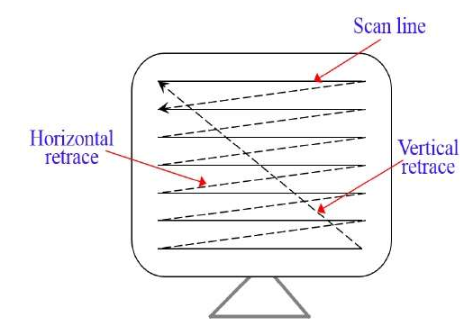

Slide 46
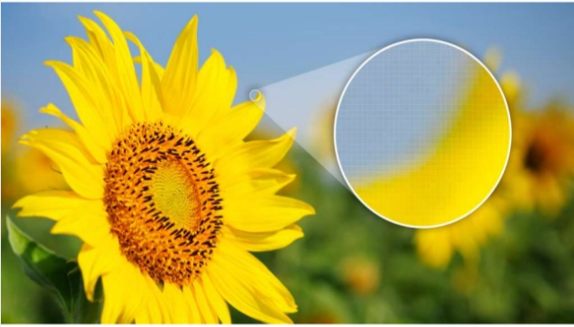
The quality of the raster image is determined by the total number of pixels (resolution) and the amount of information in each pixel (Color depth/ intensity)

Slide 47
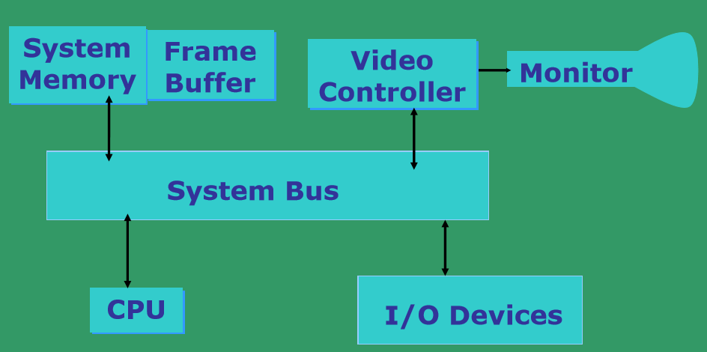
Architecture of Raster Display

Slide 48
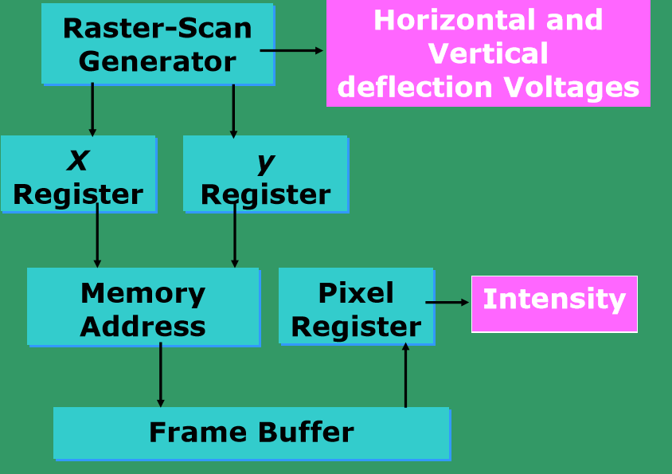
Basic Video Controller Refresh Operation

Slide 49
Raster Scan Display
Each screen point is called a pixel (picture element or pel).
Each point is an addressable point in screen and memory
Line cannot be drawn directly from one point to another
This causes the effect of ‘aliasing’, ‘jaggies’ or ‘staircase’ effect
Refresh/Frame buffer is also called Bit-plane

Slide 50
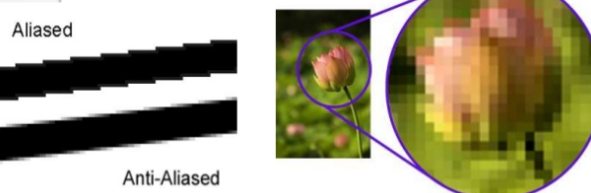

Slide 51
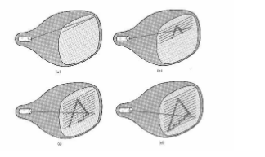
Raster Scan Display

Slide 52
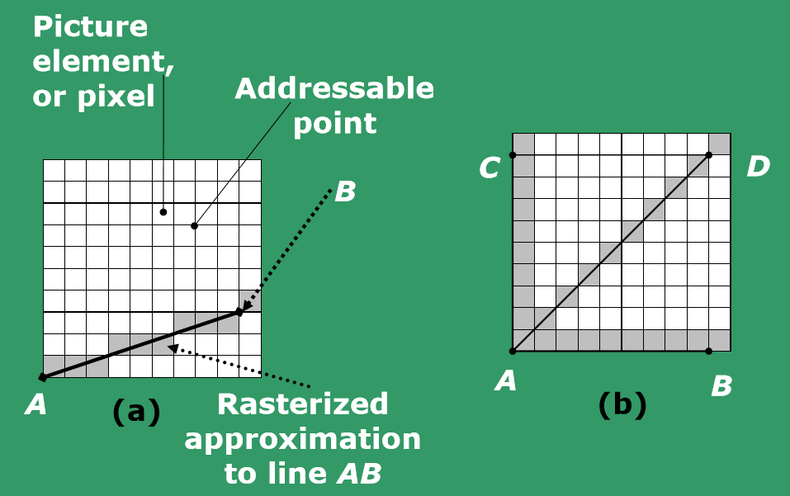
Rasterization
Rasterization: is the task of taking an image described in a vector graphics format (shapes) and converting it into a raster image (pixels or dots) for output on a video display or printer
a) General line b) Special cases

Slide 53
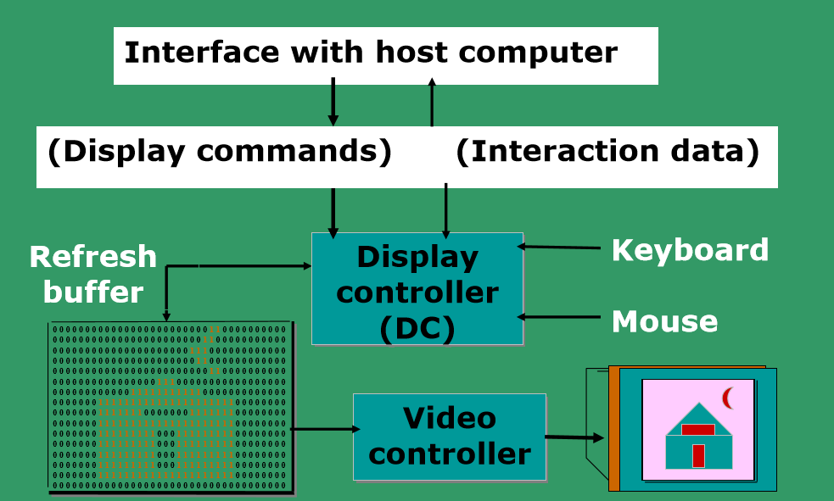
Architecture of Raster Display

Slide 54
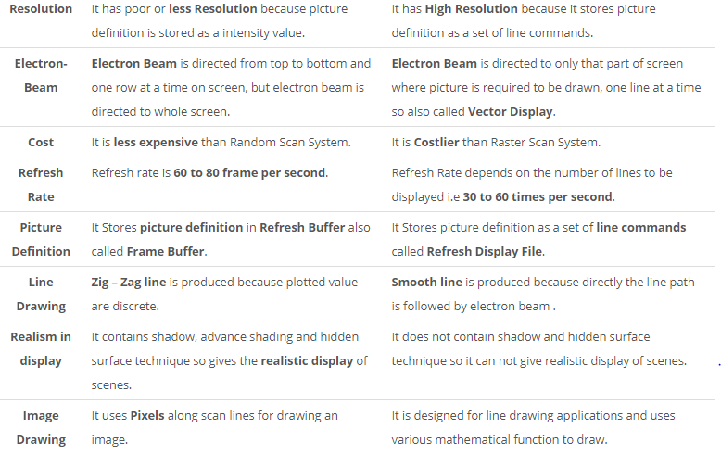
Raster Scan vs Random Scan

Slide 55
Refresh rate, Video basics and Scan Conversion
Raster is stored as a matrix of pixels representing the entire screen area
Entire image is scanned out sequentially by the video controller (one raster line at a time)
The raster lines are scanned from top to bottom and then back to the top
The intensity of the beam decides the brightness of the pixel
At least one memory bit for each pixel (called bitmap or bitplane)

Slide 56
Common Terms
Resolution: The maximum number of points that can be displayed without overlap on a CRT is referred to as the resolution.
Aspect Ratio: Aspect ratio is a number which gives the ratio of vertical points to horizontal points necessary to produce equal length lines in both directions on the screen.
Aspect ratio= width/ height
For example, if a graphic has an aspect ratio of 2:1, it means that the width is twice as large as the height

Slide 57
Bitmap or Bitplane: On a black and white system with one bit per pixel, the frame buffer is commonly known as a bitmap.
Bandwidth of the display: The rate at which the beam can be turned OFF to ON and vice-versa.
For N pixels per scan line, it is necessary to turn the electron gun at a maximum rate of: N/2 times ON and N/2 times OFF;
This will create alternate black and white lines on the screen.

Slide 58
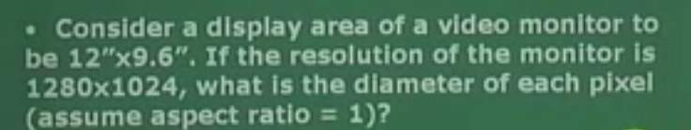
Question

Slide 59
Frame Buffer
Frame buffer or refresh buffer in raster scan displays is a memory storage area that holds the intensity values of all screen positions (pixel).
Frame buffer requires only a single bit per pixel, the amount of memory is called bitmap or bitplane.
Frame buffer requires several megabytes of storage called pixmap.

Slide 60
Refresh rate, Video basics and Scan Conversion
A typical example:
If one uses a 512x512 element raster display, memory size required in case of single bitplane frame buffer?
32 KB
Memory size required for N-bit plane gray level frame buffers:
If N=3 memory size required?
96KB

Slide 61
Color Display- Shadow Mask Method
Three electron guns instead of one inside the CRT, with one electron gun for each primary color
The phosphor coating on the inside of the display screen consists of dot patterns of three different type of phosphors
These phosphors are capable of emitting red, green, and blue light respectively
A thin metal screen called a shadow mask is placed between the phosphor coating and electron guns
The tiny holes on the shadow mask constrain each electron beam to hit its corresponding phosphor dots

Slide 62
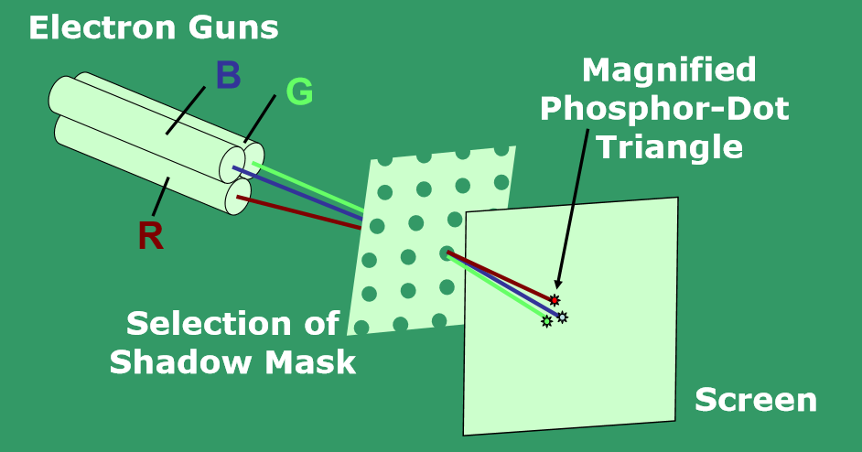
Color Display

Slide 63
Color Display- Beam Penetration Method
It is a cheaper method and is used in Vector scan displays.
In this method the inside section of CRT is coated with red (outer layer) and green (inner layer) phosphors.
If the electrons are slow they penetrate only the outer layer thus emitting red light, and if the electrons are moving fast they penetrate the outer layer and the inner layer.
The electrons speed is also adjusted in such a way that by combination of red and green, orange and yellow color are also produced.
The limitation of this method is that only four colors can be displayed in the screen.
Since we have only four colors the quality of image is diminished.

Slide 64
Beam Penetration Method V/s Shadow mask method
 | Beam Penetration method | Shadow Mask method
Where Used | It is used with Random Scan System to display color. | It is Used With Raster Scan System to display color.
Colors | It can displays Only four colors i.e. Red , Green, Orange and Yellow. | it can display Millions of colors.
Color Dependency | Less colors are available because the colors in Beam Penetration depends on the speed of the electron beam. | Millions of colors are available because the colors in Shadow Mask depends on the type of the ray.
Cost | It is Less Expensive as compared to Shadow Mask. | It is More Expensive than other methods.
Picture Quality | Quality of picture is not so good i.e. Poor with Beam Penetration Method. | Shadow Mask gives realism in picture with shadow effect and millions of color.
Resolution | It gives High Resolution. | It gives Low Resolution.
Criteria | In Beam Penetration method, Color display depends on how far electron excites outer Red layer and then Green layer. | In Shadow Mask Method, there are no such criteria for producing colors. It is used in computers, in color TV etc.

Slide 65
Full Color Frame Buffer
Typically 8-bit planes per color is used, which gives 24-bit plane frame buffer.
Each group of bit-planes drives an 8-bit DAC.
Each group generates 256 shades of intensities of red, green or blue.
Hence we obtain 2^24= 16,777,216 possible colors.
This is called a full color frame buffer.

Slide 66
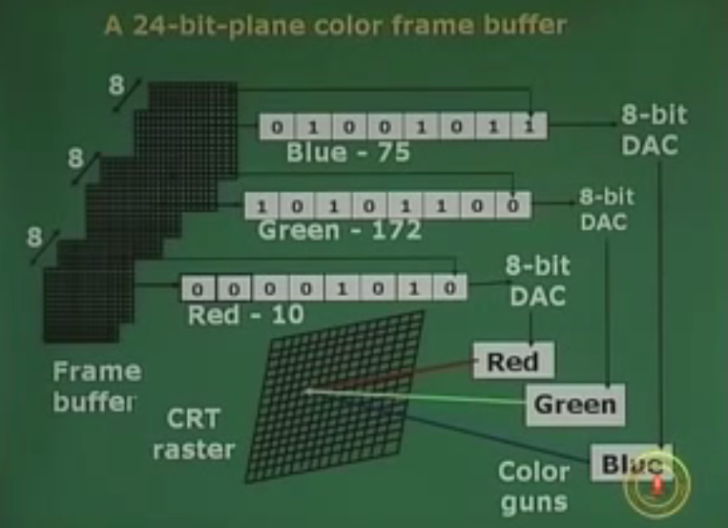

Slide 67
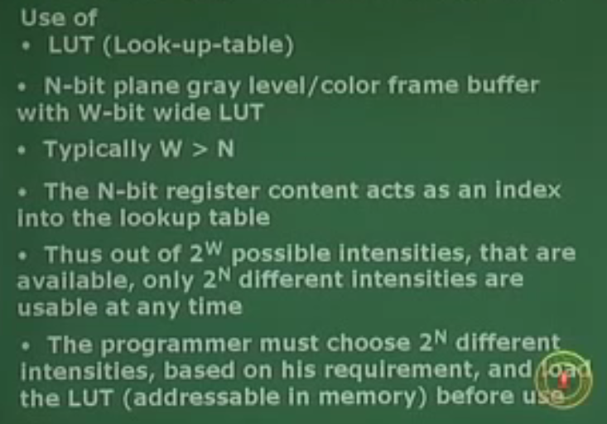
LookUp Table

Slide 68
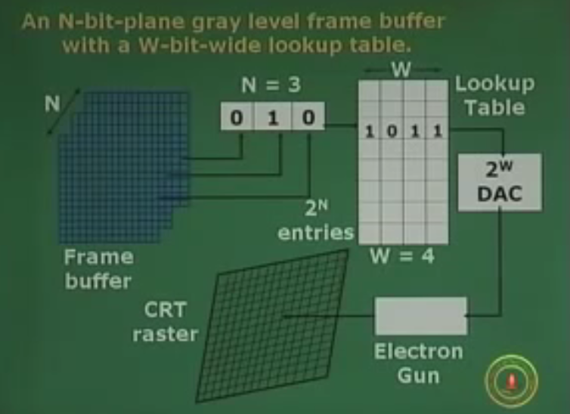

Slide 69
Questions
1) Find out the time required to scan one row of screen if the screen resolution is 20MP(mega pixel) , aspect ratio 5/4 and refresh frequency is 30Hz).
2) How much time is spent scanning across each row of pixels during screen refresh on a raster system with resolution of 1280 X 1024 and a refresh rate of 60 frames per second?

Slide 70
Questions
3) Consider three different raster systems with resolutions of 640 x 480, 1280 x 1024, and 2560 x 2048.
What is the size of frame buffer (in bytes) for each of these systems to store 12 bits per pixel?
How much storage (in bytes) is required for each system if 24 bits per pixel are to be stored?
4) Find out the aspect ratio of the raster system using 8 x 10 inches screen and 100 pixel/inch.

Slide 71
Questions
5) Consider two raster systems with the resolutions of 640 x 480 and 1280 x 1024.
How many pixels could be accessed per second in each of these systems by a display controller that refreshes the screen at a rate of 60 frames per second?
What is the access time per pixel in each system?

Slide 72
6) Suppose raster system is to be designed using on 8 inch X 10 inch screen with a resolution of 100 pixels per inch in each direction. If we want to store 6 bits per pixel in the frame buffer, how much storage (in bytes) do we need for frame buffer?
7) Consider a raster system with the resolution of 1024 x 768 pixels and the color palette calls for 65,536 colors. What is the minimum amount of video RAM that the computer must have to support the above-mentioned resolution and number of colors?

Slide 73
8) Compute the following:
(a) Size of 800 x 600 inch image at 240 pixels per inch.
(b)Height of the resized image 1024 x 768 to one that is 640 pixels wide with the same aspect ratio.
(c)Width of an image having height of 5 inches and an aspect ratio 1.5

Slide 74
9) Find out the size of frame buffer in MB if the screen resolution is 12MP (mega pixel), aspect ratio 3/4 and number of color combination required 12345.(RGB all are having equal no. of Frame buffer).
10) Find the number of colors a frame buffer of 8 bit planes each red, green and blue, and 10 bits wide lookup table can produce.
11) Find the amount of memory required by an 8 plane frame buffer each of red, green and blue, having 1024x 768 resolution.

Slide 75
12) Find the refresh rate of a 512 x 512 frame buffer, if the access time for each pixel is 200 nanoseconds(ns).
13) Find the amount of memory required by a 3 plane frame buffer each of red, green and blue, having 800 x600 resolution
14) Find the refresh rate of a 1024 x 1024 frame buffer, if it can access 32 pixels in a group simultaneously, in an access time of 200 ns.

